Slide 1
Team Vision
TeaM Members:
1.Piyush Kumar Das
2.Navin Kumar Barnwal
3.Vrushali Vijay Harane

Slide 2
Problem Statement:
Topic number 2: To build a conversational solution that enables customers to discover and order products.
With the technological advancements, customers are expecting a smooth and easy to use interface that will save their time for surfing through thousands of products on the site.
A conversational bot can satisfy the above expectation by providing everything customer wants through mere chats .This motivated us to work on this topic.

Slide 3
Approach:
We built a chatbot named ‘Vision’ that takes user’s input in the form of search queries and gives him/her output in the form of expected URL links .
We approached this problem by using 2-layered neural networks architecture and fundamentals of Natural language processing.
A small scale model of e-commerce website was made. We made our training set corresponding to it.

Slide 4
Through the fundamentals of NLP , user input was identified.
Through 2-layered neural network, we developed an efficient mapping function that maps user input to the expected responses and URLs on the basis of trained model.
The mapped output is then displayed in the chatbot as a response.
We followed the guidelines of ‘Prototype model’ of Software development cycle. Prototype was built and tested and again improvements were done.

Slide 5
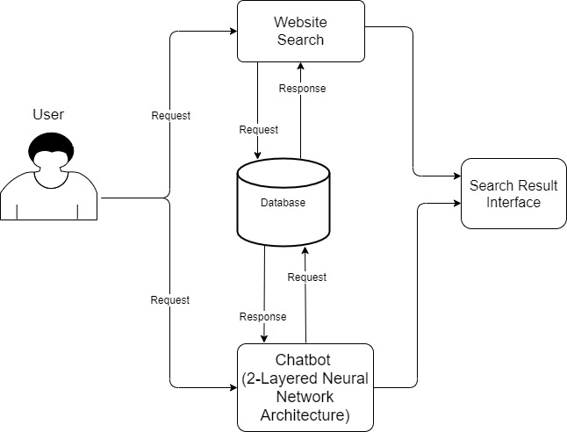
Workflow diagram

Slide 6
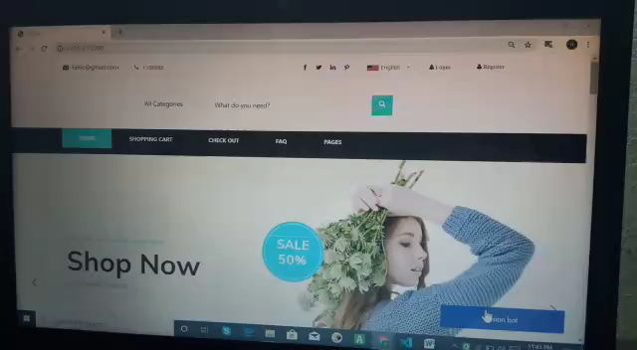
Demo Video

Slide 7
Technologies Used:
Django frame-work for backend.
HTML, CSS and Javascript for front-end.
Python libraries specifically Tensor flow, NLTK, Numpy for designing chatbot.
Fundamentals of Natural Language Processing and Deep Learning.

Slide 8
Challenges Faced:
Building training set for chatbot by analyzing different customer interactions and expectations.
Developing interactive user interface for chatbot on our e-commerce site.
Returning correct search results and adding orders of user to cart through chatbot interaction.
99% complete syndrome(to some extent).

Slide 9
Thank You!

